Slide 1



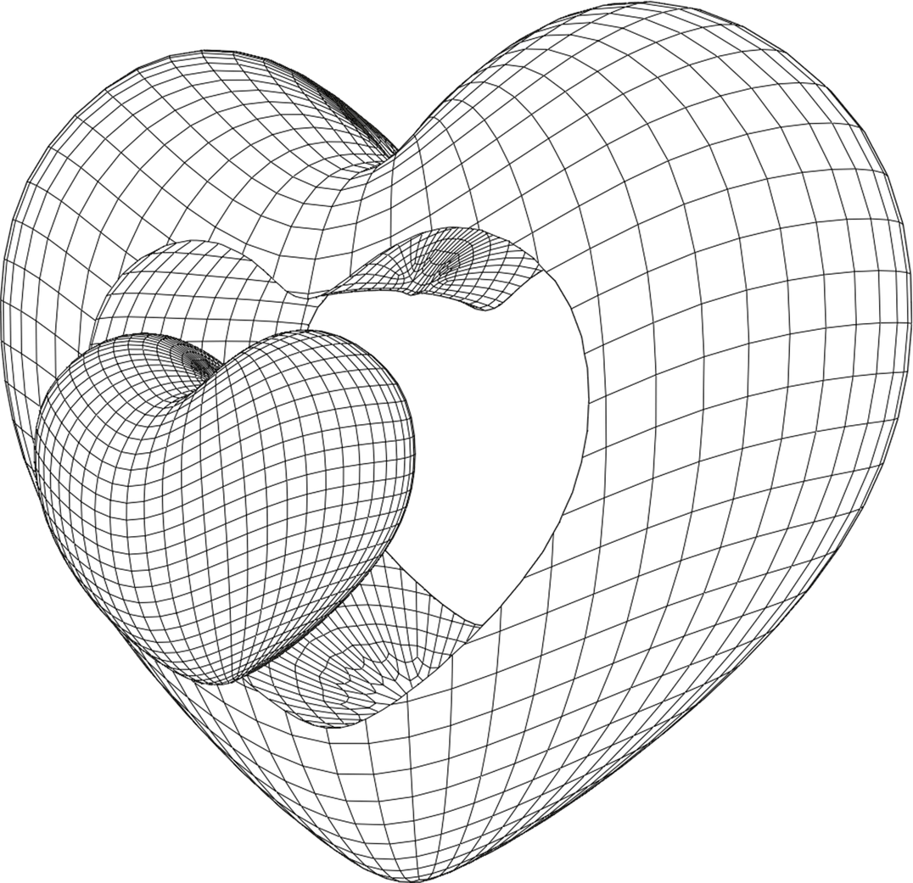
SOCIAL MEDIA

Slide 2
TABLE OF CONTENT
1
WHAT IS SOCIAL MEDIA
6
SOCIAL MEDIA & AGE RANGES
2
HISTORY WITH PROBLEMS & SOLUTIONS
7
EFFECTS OF SOCIAL MEDIA
3
TYPES OF SOCIAL MEDIA
8
HOW BUSINESSES USE SOCIAL MEDIA
4
HOW SOCIAL MEDIA WORKS
9
EXPECTATIONS / FUTURE OF SOCIAL MEDIA
5
WHY PEOPLE PREFER SOCIAL MEDIA
10
CONCLUSION & Q&A

Slide 3



WHAT IS SOCIAL MEDIA?
DEFINITION
EXAMPLES
PURPOSE
Platforms that allow people to create, share, and interact online
Facebook, Instagram, TikTok, X (Twitter)
From Communication to Connection

Slide 4
2000
2004
2005
2006
2016
FRIENDSTER & MY SPACE
FACEBOOK
YOUTUBE
TWITTER (X)
TIKTOK
Online Communities
Easy Connection
Share Videos
Quick Updates & News
Short Videos
HISTORY
Social media began in the late 1990s and early 2000s with platforms like Six Degrees, MySpace, and Friendster, which allowed people to connect and share online. It rapidly evolved with the rise of Facebook, Twitter, Instagram, and TikTok, shaping global communication, culture, and business.

Slide 5
SOCIAL MEDIA TYPES
Exploring Categories of Social Media
SOCIAL NETWORKS
MEDIA SHARING
MESSAGING APPS
FORUMS & COMMUNITIES
PROFESSIONAL PLATFORMS
FACEBOOK
INSTAGRAM
WHATSAPP
REDDIT
LINKEDIN
LINKEDIN
YOUTUBE
MESSENGER
QUORA
RESEARCHGATE
TIKTOK
TELEGRAM

Slide 6
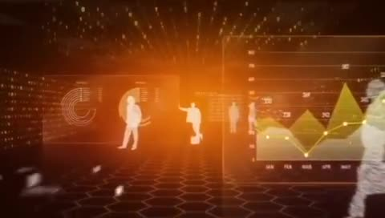
SOCIAL MEDIA ALGORITHMS
Algorithms are sets of rules and calculations used by social media platforms to decide what content users see.
Purpose: To personalize the feed, keep users engaged, and match them with relevant content.

Slide 7





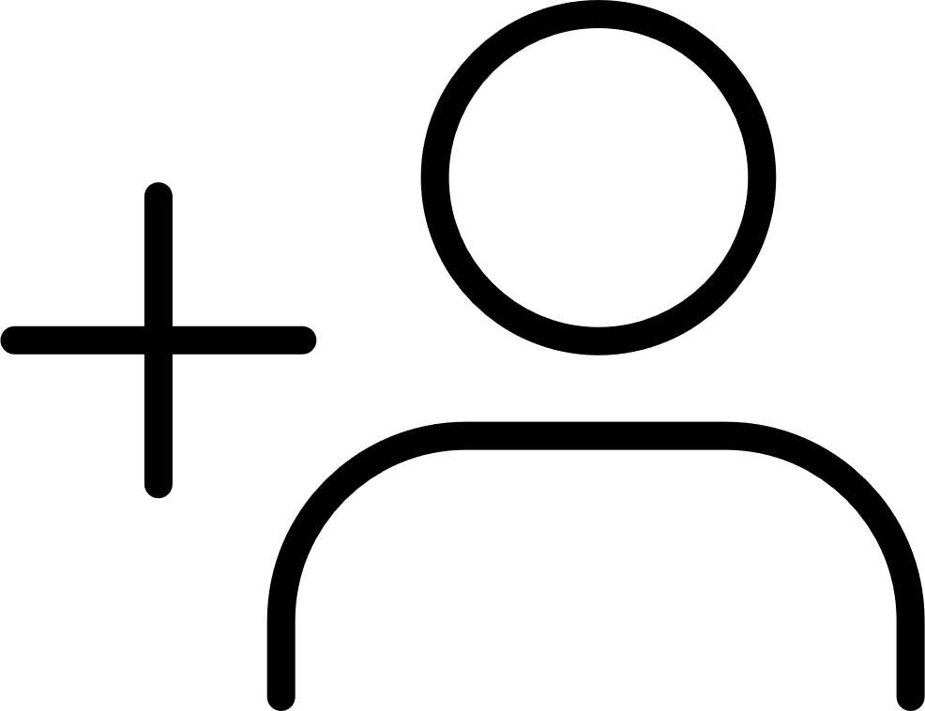


KEY FACTORS INFLUENCING ALGORITHMS
78 POSTS
345 FORWARDS
45468 LIKES
2460 SHARES
1268 COMMENTS
6453 FOLLOWERS
13464 SAVES
120K VIEWS
Engagement: Likes, comments, shares, watch time.
Relevance: How closely the content matches user interests.
Recency: Newer posts often rank higher than old ones.
80 POSTS
500 FORWARDS
70K LIKES
4000 SHARES
Relationships: Posts from friends/followed accounts are prioritized.
2K COMMENTS
10K FOLLOWERS
20K SAVES
220K VIEWS

Slide 8
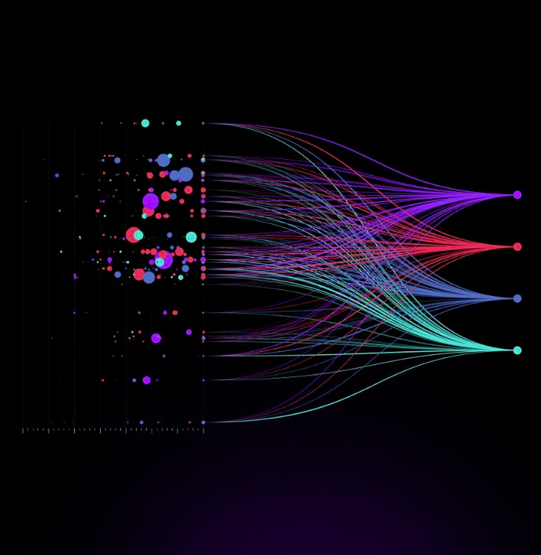
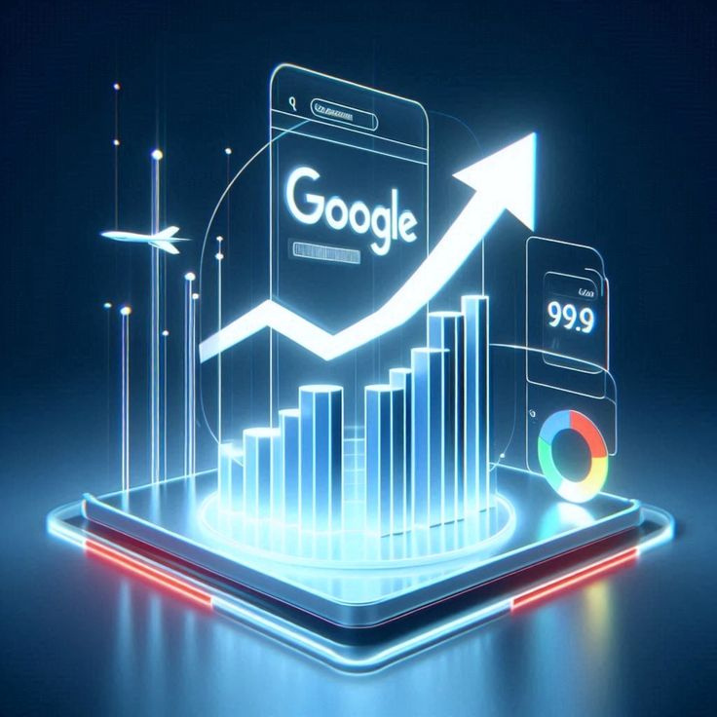
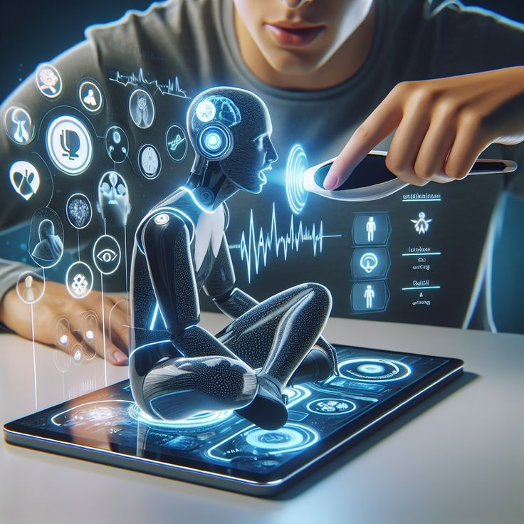


HOW THE PROCESS WORKS
Data Collection – Platform gathers info (your clicks, watch history, searches).
Content Ranking – Algorithm scores posts based on factors
Personalized Feed – High-scoring posts are shown first in your timeline.
5K
5K
5K
5K
5K
5K
5K
5K
5K

Slide 9

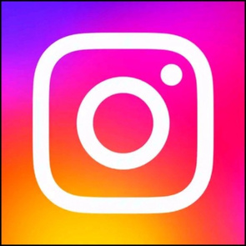


EXAMPLES IN ACTION
@Facebook
@Instagram
Balances between personal connections & trending news.
Prioritizes friends + similar interest posts.
5K
5K
5K
5K
5K
5K
How TikTok, Instagram, YouTube, and Facebook use algorithms
@TikTok
@YouTube
Focus on watch time & replays.
Recommends based on watch history & video performance.
5K
5K
5K
5K
5K
5K

Slide 10
PROS & CONS
Pros:
Cons:
Personalized experience.
Helps discover relevant content.
Boosts creators’ reach if engaging.
Can create echo chambers.
May spread misinformation.
Hard for new creators to get noticed.

Slide 11
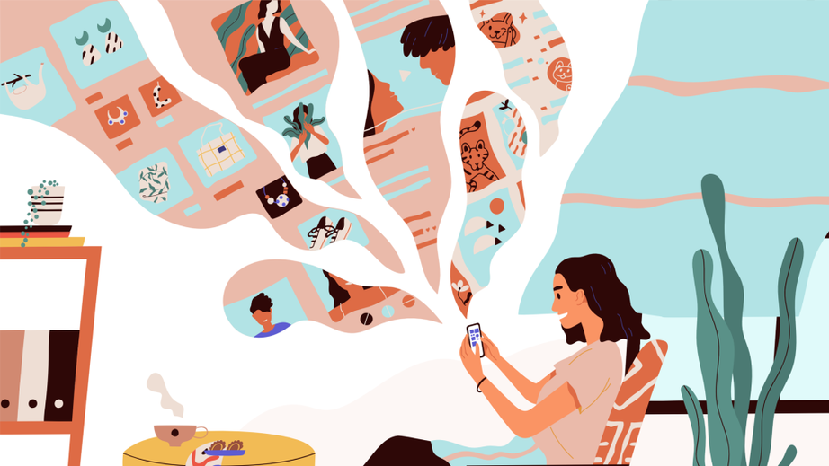
WHY PEOPLE PREFER SOCIAL MEDIA
Social media has become an essential part of modern life.
Billions of people use it daily for different purposes.
It is not only a tool for fun, but also for learning, news, and career opportunities.
Why do you think people prefer social media?

Slide 12
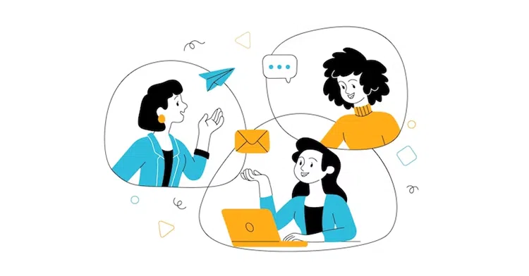
1. EASY COMMUNICATION
Social media makes it simple to connect with anyone, anytime, anywhere.
Free messaging, voice, and video calls allow people to stay close even if they are far apart.
Sharing photos, stories, and life updates has become faster and easier than ever.
It breaks down distance and time barriers, making global communication possible.

Slide 13

2. ENTERTAINMENT & NEWS
People use social media for entertainment: videos, reels, memes, and live streams.
It is also a quick source of information and breaking news around the world.
Social platforms let us follow celebrities, influencers, and global trends instantly.
Unlike traditional media, social media gives real-time updates anytime, anywhere.

Slide 14

3. SENSE OF COMMUNITY
Social media helps people find others with the same interests, hobbies, or goals.
Online groups and communities create a feeling of belonging and support.
People can celebrate events, share cultures, and connect with different backgrounds.
It builds relationships and friendships beyond physical borders.

Slide 15
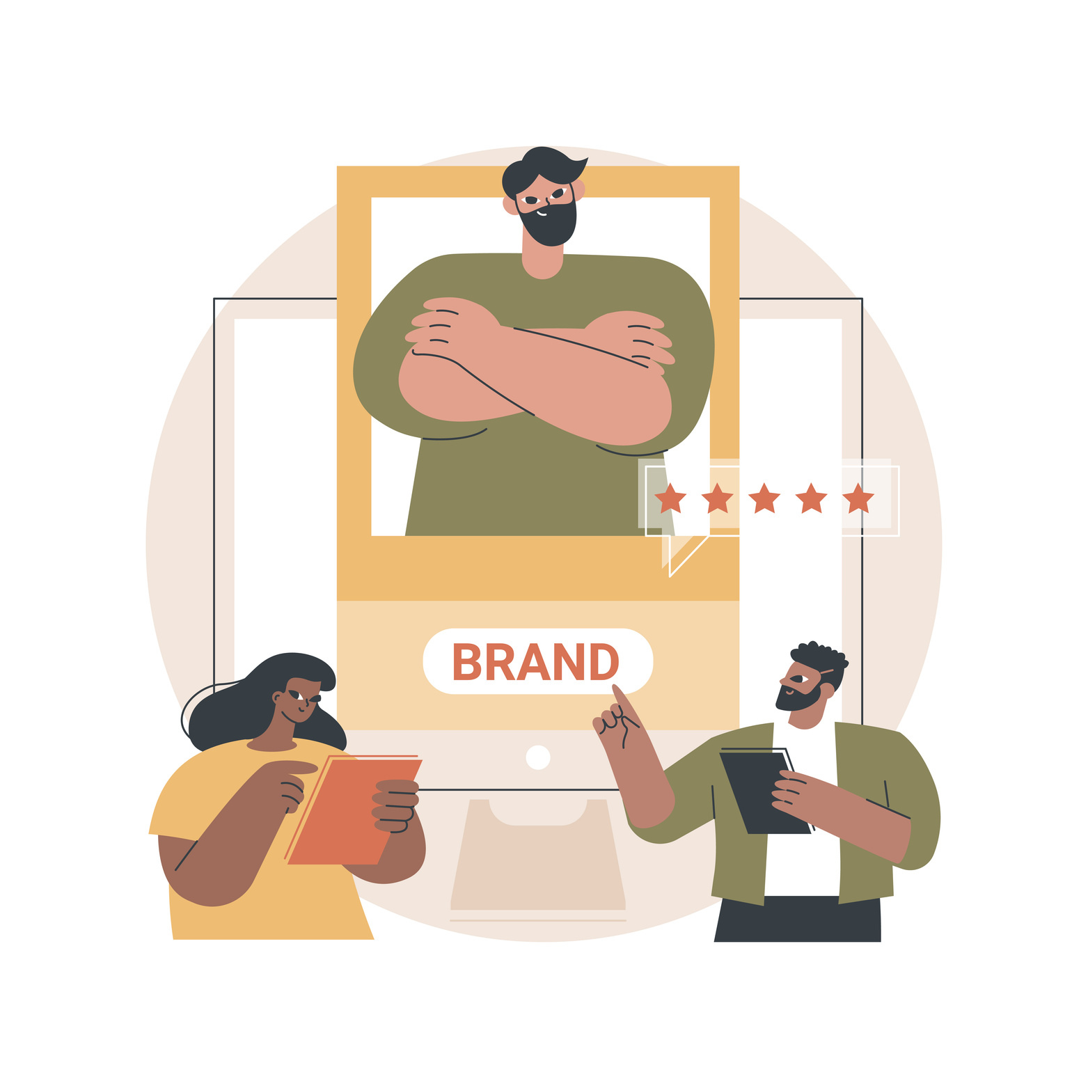
4. PERSONAL BRANDING
Social media allows individuals to create and control their online identity.
People share skills, talents, and achievements to build credibility.
Businesses and freelancers use it for promotion, marketing, and growth.
Personal branding on social media can lead to career opportunities and success.

Slide 16
AGE RANGE
Not only adults use social media but all of ages use it so let us see who is using it and how

Slide 17
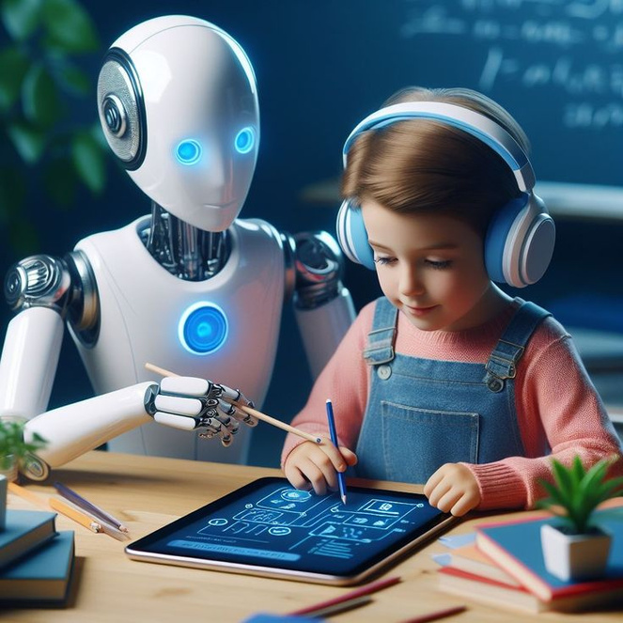
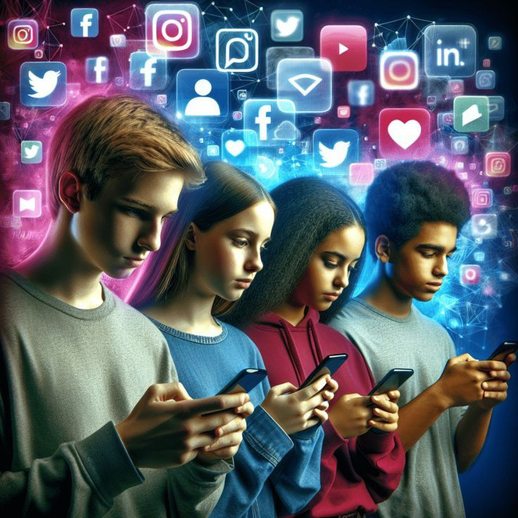

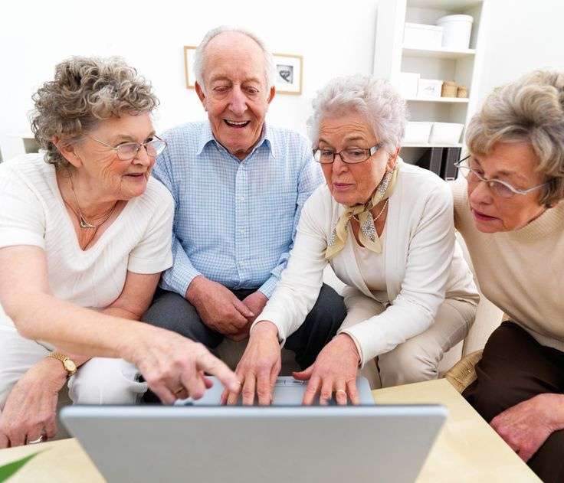
Entertainment & Trends
Use social media for fun, short, and trendy content.
Favorite platforms: TikTok, Instagram, Snapchat.
Enjoy memes, challenges, and viral videos.
Networking & Personal Branding
Use social media to connect with people and build networks.
Focus on personal branding on LinkedIn and Instagram.
Share inspirational, creative, or educational content.
News & Family Updates
Rely on social media for news, politics, and current events.
Stay updated with family and friends through posts and photos.
Popular platforms: Facebook, Twitter.
Staying Connected
Use social media mainly to connect with children and grandchildren.
Prefer easy-to-use platforms like Facebook and WhatsApp.
Helps them avoid feeling isolated and stay socially active.

Slide 18
EFFECTS OF SOCIAL MEDIA
POSITIVE IMPACTS
NEGATIVE IMPACTS
IS THE POSITIVE IMPACT BIGGER THAN THE NEGATIVE?

Slide 19
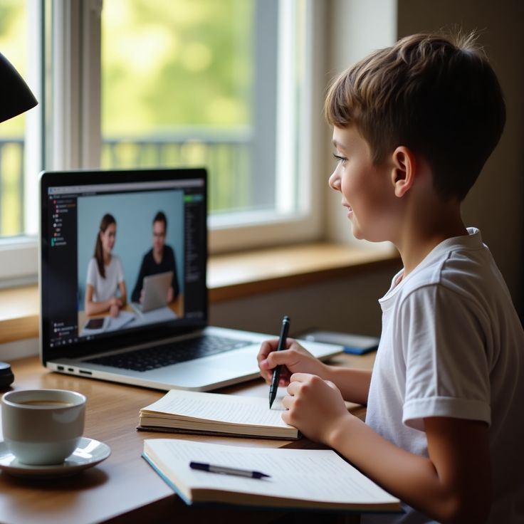


POSITIVE EFFECTS
Learning: Access to free knowledge & tutorials
Networking: Connects people worldwide, job opportunities
Awareness: Spreads news & social causes quickly
5K
5K
5K
5K
5K
5K
5K
5K
5K

Slide 20
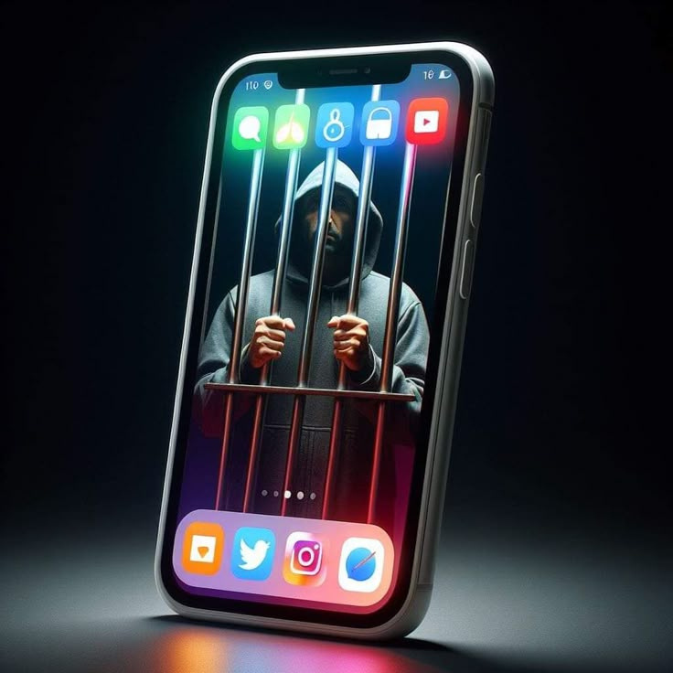
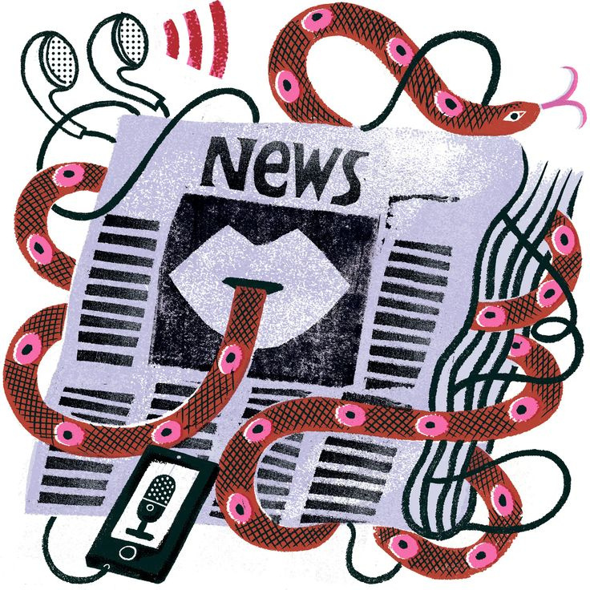
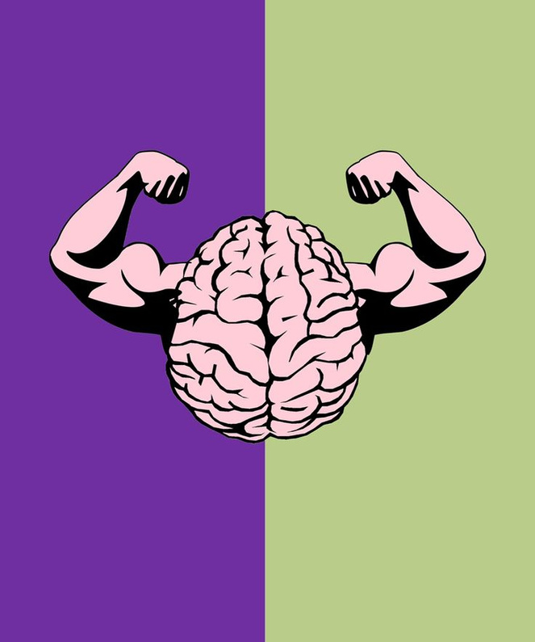
NEGATIVE IMPACTS
Addiction: Excessive screen time, distraction
Misinformation: Fake news spreads fast
Mental Health: Anxiety, depression, low self-esteem
5K
5K
5K
5K
5K
5K
5K
5K
5K

Slide 21
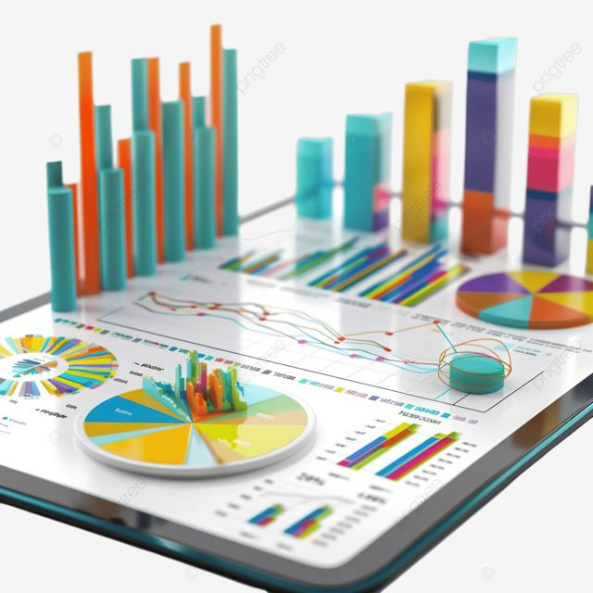
STATISTICS
Average global time spent on social media = ~2.5 hours/day
Teenagers check social media 90+ times/day
70% of people report seeing fake news online

Slide 22
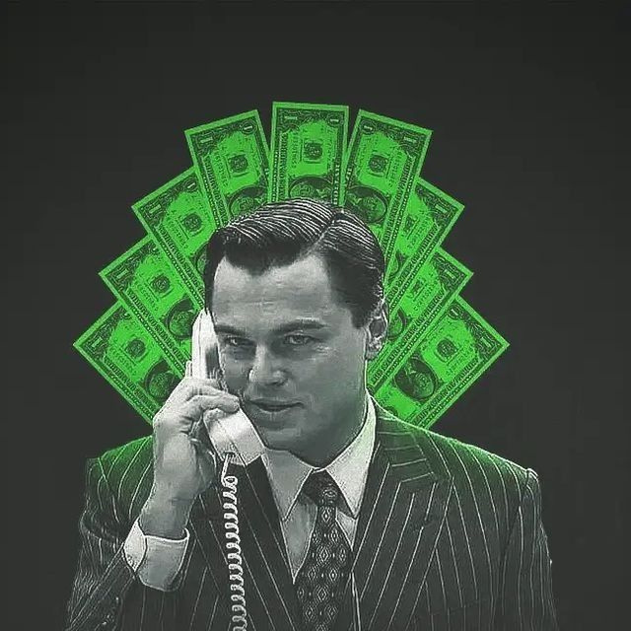
HOW BUSINESSES USE SOCIAL MEDIA
MARKETING & ADS
Promote products & services
Targeted ads to specific audiences
Cost-effective compared to traditional ads

Slide 23

CUSTOMER SERVICE
Quick responses to questions & complaints
Builds trust & customer loyalty
Many companies use chatbots on social media

Slide 24
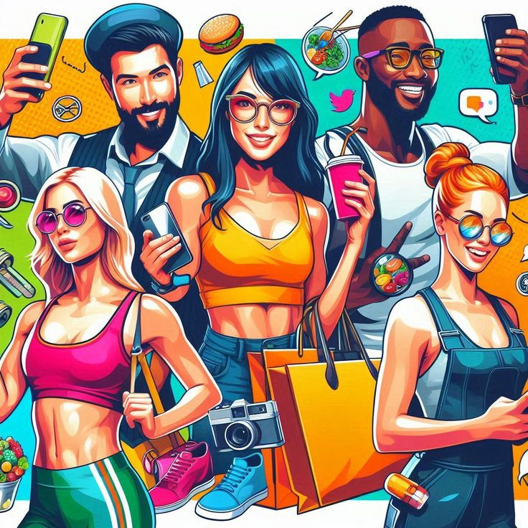
INFLUENCER COLLABORATIONS
Quick responses to questions & complaints
Builds trust & customer loyalty
Many companies use chatbots on social media

Slide 25

DATA & INSIGHTS
Track customer behavior & preferences
Analyze engagement (likes, shares, comments)
Helps businesses make better decisions

Slide 26
FUTURE OF SOCIAL MEDIA
SOCIAL MEDIA IS ALWAYS CHANGING.
IN THE FUTURE, IT WILL BECOME MORE ADVANCED AND MORE CONNECTED TO OUR DAILY LIVES.
WHAT CAN WE EXPECT IN THE COMING YEARS?

Slide 27
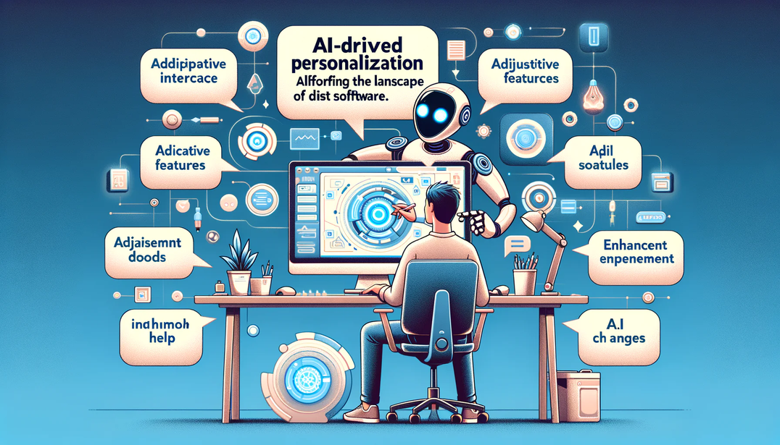
1. MORE AI-DRIVEN PERSONALIZATION
Artificial Intelligence will shape how we use social media.
Platforms will suggest content based on personal habits, interests, and behavior.
Smarter algorithms will improve ads, recommendations, and user experience.
The experience will become more “tailored” for each individual.

Slide 28
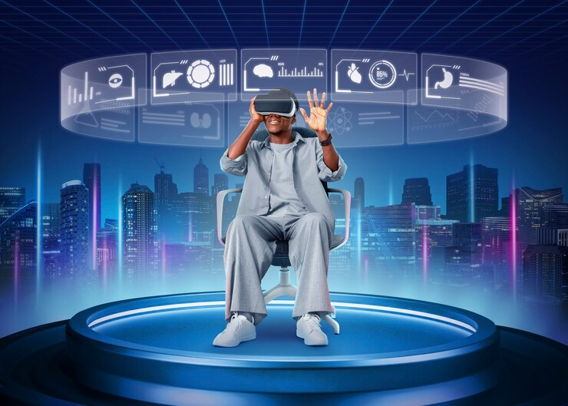
2. VR & METAVERSE INTEGRATION
Social media will move beyond screens into immersive worlds.
Virtual Reality (VR) and Augmented Reality (AR) will allow people to interact in 3D spaces.
The “Metaverse” could replace traditional social platforms with virtual environments.
People will attend events, shop, and socialize in these digital worlds.

Slide 29

3. STRICTER PRIVACY & SECURITY
With more users and data, privacy will be a major concern.
Platforms will introduce stronger rules for data protection.
Transparency about how personal information is used will increase.
Users will expect safer online environments with fewer risks.

Slide 30
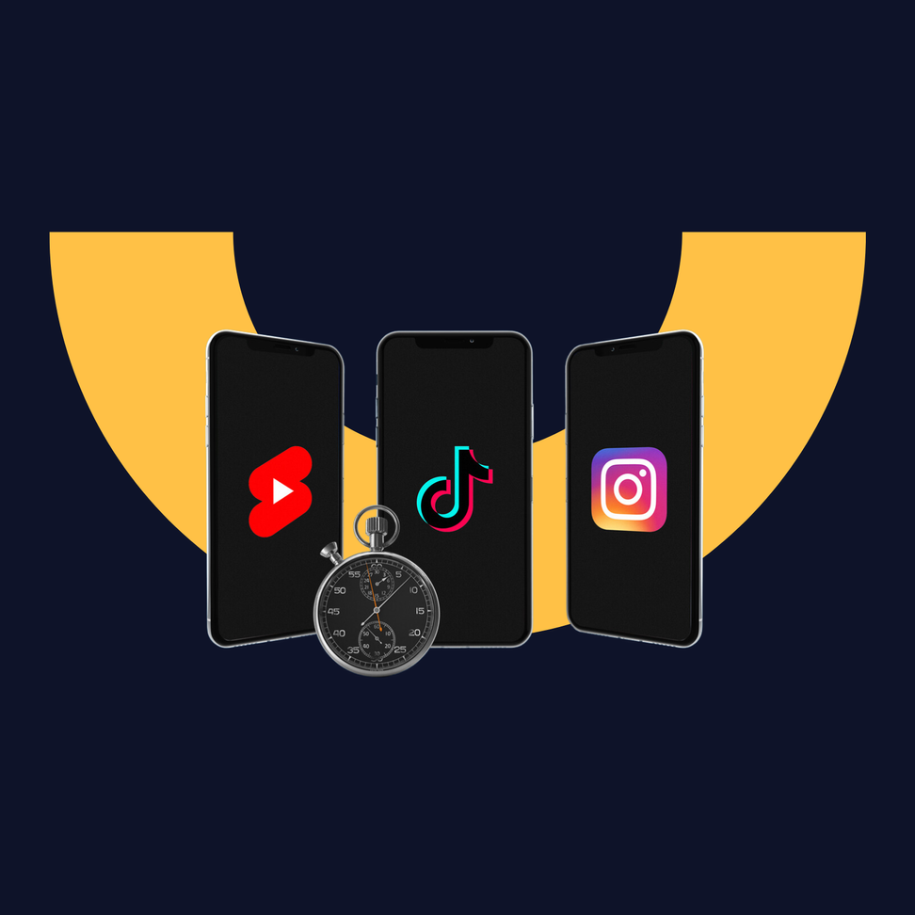
4. RISE OF SHORT-FORM CONTENT
Short videos and quick posts are the future of communication.
Platforms like TikTok, Reels, and Shorts are leading this trend.
Attention spans are getting shorter, so content will be faster and more engaging.
Brands and creators will focus on delivering value in a few seconds.

Slide 31
CONCLUSION
Social media is just a tool – It can be positive or negative depending on how we use it.
Example: It can spread knowledge OR spread fake news.
It connects billions of people around the world.
Families, businesses, friends, communities.
It requires responsibility from every user.
Think before you share.
Be aware of privacy and online safety

Slide 32
THANK YOU

